Slide 1
Precision Agriculture
By
Jocelyn Quadras
Sagar Oza
Akshay Gurao

Slide 2
What is Precision Agriculture?
Technique of observing, measuring and responding to the variability in crops.
Traditional agricultural practices involve farmers performing the tasks against the pre-determined schedule.
With Precision agriculture Application, Farmers can track information about their farms in real-time and make proactive decisions to improve crop productivity.

Slide 3
How is this achieved?
Sensors are placed in farms to keep track of the temperature, soil moisture, soil temperature, humidity of the soil etc.
By collecting real-time data on weather, soil and air quality, crop maturity, predictive analytics can be used to make smarter decision.
The information collected will help farmers make the best decision with regards to planting, fertilizing and harvesting crops.

Slide 4
Scope of the Project
Monitor Farmer’s Farming activity at each stage and suggest predictive results
Enter seed name in the Application which is to be harvested and get information about the seeds resistance to weather conditions
Determine when to irrigate field and automate the irrigation activity as to precisely track the irrigation activity
Track the complete farming stage
Send data to Lab for Testing and get Accurate Fertilizer Quantity and Fertilizer Name

Slide 5
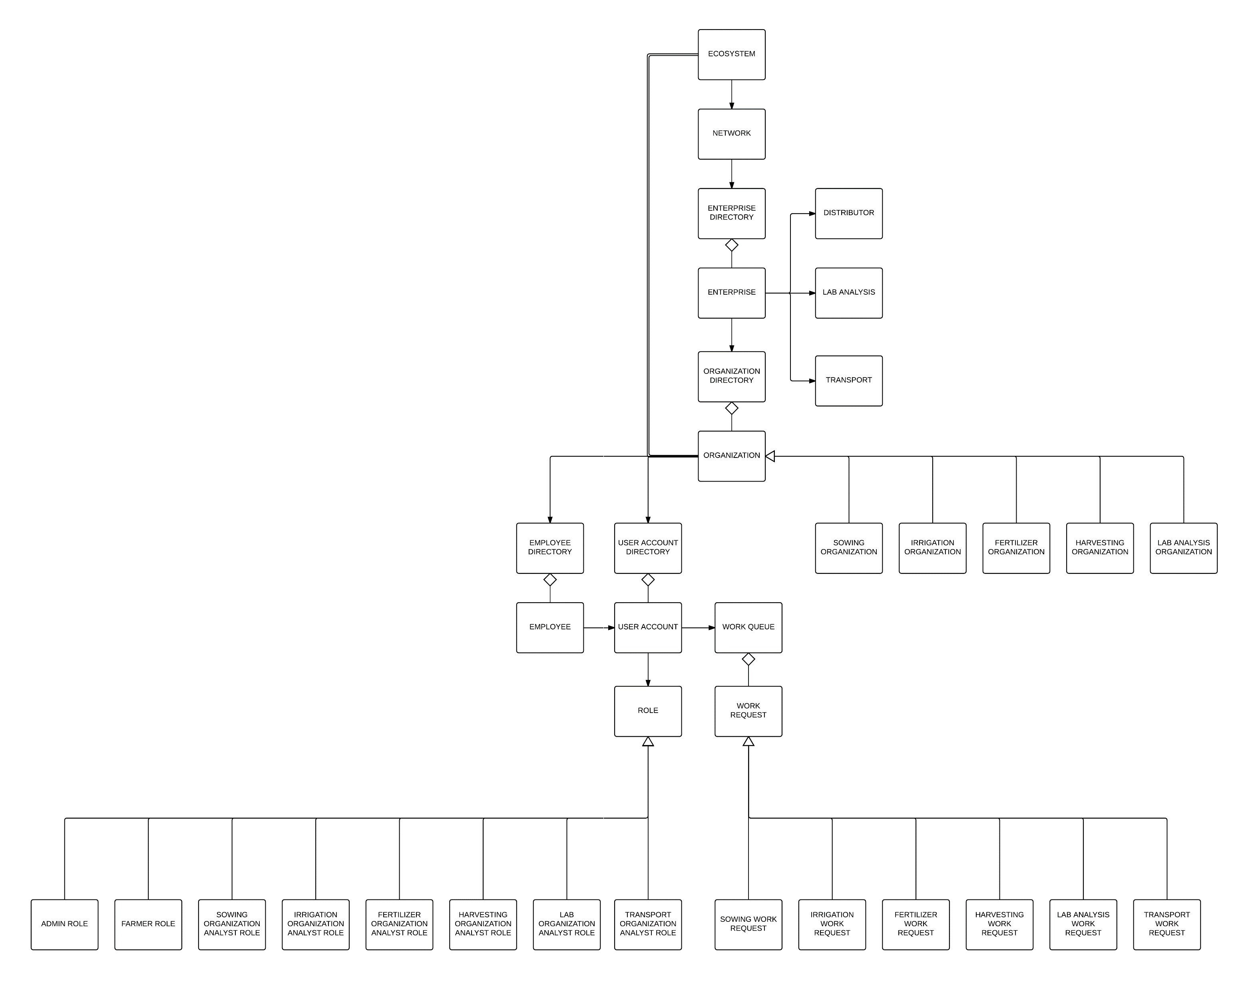
Object Model

Slide 6
Enterprise Type
Distributor
Manages the Sowing, Irrigation, Fertilizer and Harvesting Organization
Roles- Sowing , Fertilizer, Irrigation and Harvesting Analyst
Lab
Manages the lab Organization
Roles- Lab Analyst
Transporter
Manages the transport Organization
Roles- Transport Coordinator

Slide 7
Farmer
Part of Enterprise
Created by Enterprise Admin
Farmer data stored in Farmer Directory
Contains 4 Activity
Sowing Task
Irrigation Task
Fertilizer Task
Harvesting Task

Slide 8
Sowing Analyst
Gets work request from farmer to start sowing
Assigns request to its work queue from the Sowing Organization queue
Monitors the work request assigned to him
Track the status of the work request as and when changed by farmer
Reports the work request to the Irrigation Organization work queue

Slide 9
Irrigation Analyst
Gets the request from the Farmer to start Irrigation
Irrigation activity handled by Irrigation Analyst
Decides when to start and stop Irrigation
Assigns the work request to its work queue
Reports the work request to Fertilizer Analyst once sowing done

Slide 10
Fertilizer Analyst
Gets the work request from the work queue of the fertilizer organization
Assigns the work request to its work queue
Monitor’s the status of the Fertilization task as and when the farmer starts and stop’s fertilization
Reports the Work Request to Harvesting Analyst once Fertilization is done

Slide 11
Harvesting Analyst
Gets the work request from the work queue of the Harvesting organization
Assigns the work request to its work queue
Monitor’s the status of the Harvesting task as and when the farmer starts and stop’s Harvesting
Request the transport of harvesting goods to Transport Organization of Transport Enterprise(Inter Enterprise Communication)

Slide 12
Lab Analyst
Gets request from the Farmer to conduct soil Analysis
Send back the Analysed data back to Farmer
Picks up the work request sent by Farmer to conduct Analysis and adds it to its work queue

Slide 13
Transport Coordinator
Gets the work request from Harvesting Analyst and adds it to its work queue
Starts the transport of the Produced goods once gets the request to start packaging and pick up
Ends the Farming activity
InterEnterprise Communication Enabled

Slide 14
Reports generated the Ecosystem Level
Top Producing Farmers
Profit from each Enterprise
List of top Producing Farmers

Slide 15
Reports generated the Enterprise Level
Quantity of Crops Produced
Farmers Task Completion data at each each task

Slide 16
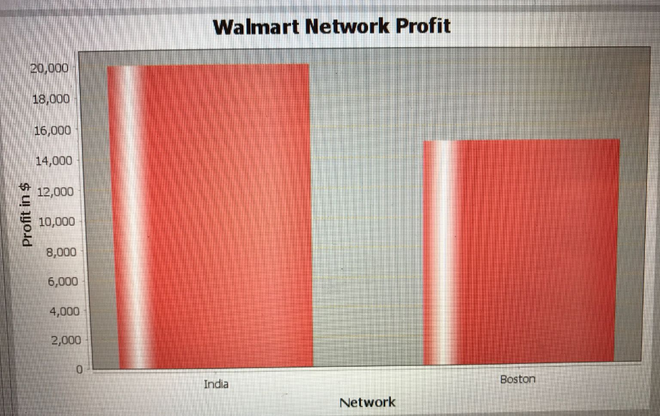

Slide 17
Conclusion
With the help of our precision agriculture application, food production can be increased, minimize environmental impact and greater sustainability.
Can track data at each stage of the Farming and suggests reasonable changes

Slide 18
Future Scope
Mobile apps with real time analysis of Farm at each stage
Bank Enterprise with Farmer able to take and manage Loan

Slide 19
Thank you.

